Slide 1
The impact of economic sanctions on food (prices) security
by S. K. Afesorgbor, L. Kornher, F. G. Santeramo
Discussion by A. Cheptea (INRAE)
Analyses the impact of sanctions on food prices and hunger (prevalence of undernourishment)
Contributions:
Provide new knowledge (literature limited to anecdotal evidence and case study analyses)
Analyze impacts on food inflation and on food security (food prices are an essential element thereof)
Explore the heterogeneity of effects (across the type of sanctions and senders)
Unveil a number of mechanisms at work: demand and supply shocks, trade, productivity, foreign aid, …
Empirical analysis:
Sanctions imposed by 30 Western economies and multilateral organizations
Impact on food prices and food security in 99 developing countries
Approach: sanctions are not exogenous! ⇒ use conditional dif-in-dif; build the control group using entropy balancing
Main findings:
Sanctions inflate food prices by 1.4–2.3%, and deteriorate food security; significant and heterogeneous effects

Slide 2
The impact of economic sanctions on food (prices) security– Discussion by A. Cheptea
Clarifying questions:
The time span of the analysis: 1990-2022 ? List sender and target countries
The type of sanctions in the analysis:
Economic sanctions can be very different: give some examples
Only sanctions against governments? Also sanctions against individual organizations and persons?
How do you treat overlapping sanctions?
Data structure:
each country pair includes years with sanctions and years without sanctions?
data includes lifted/removed sanctions?
data includes country pairs that never engage in sanctions?
Entropy balancing (used for obtaining an exogenous control group):
based on data in pre-sanction years?
the control group formed only by countries that were never sanctioned?

Slide 3
The impact of economic sanctions on food (prices) security– Discussion by A. Cheptea
Comment 1: How match country-specific dependent variable and bilateral explanatory variable?
$Y_{it}=α_{0}+γ X_{it}+β Sanctions_{ijt}+α_{i}+α_{j}+α_{t}+ε_{it}$ ⇒ Artificially inflated data if $Y_{it}$ expanded for each j
Country level analysis as an alternative: $Y_{it}=α_{0}+γ X_{it}+β Nb_sanctions_{it}+α_{i}+α_{t}+ε_{it}$
Comment 2: The estimated impact on food prices is quite small
Annual variations in food price indices
Food prices vary more. Explore higher frequency data (s.d. or var of monthly food CPI).
Price indices hide differences in product composition ⇒ explore the product dimension.
Targeted countries rely quite heavily on food imports ⇒ impact on import prices may be stronger.
Comment 3: How to interpret the estimated impact on food security (undernourished population)
How much is due to higher food prices? Prices reflect access to food
Other dimensions of food security (availability, use and utilization, stability)?

Slide 4
The impact of economic sanctions on food (prices) security– Discussion by A. Cheptea
Comment 1: How match country-specific dependent variable and bilateral explanatory variable?
$Y_{it}=α_{0}+γ X_{it}+β Sanctions_{ijt}+α_{i}+α_{j}+α_{t}+ε_{it}$ ⇒ Artificially inflated data if $Y_{it}$ expanded for each j
Country level analysis as an alternative: $Y_{it}=α_{0}+γ X_{it}+β Nb_sanctions_{it}+α_{i}+α_{t}+ε_{it}$
Comment 2: The estimated impact on food prices is quite small
Annual variations in food price indices
Food prices vary more. Explore higher frequency data (s.d. or var of monthly food CPI).
Price indices hide differences in product composition ⇒ explore the product dimension.
Targeted countries rely quite heavily on food imports ⇒ impact on import prices may be stronger.
Comment 3: How to interpret the estimated impact on food security (undernourished population)
How much is due to higher food prices? Prices reflect access to food
Other dimensions of food security (availability, use and utilization, stability)?

Slide 5
The impact of economic sanctions on food (prices) security– Discussion by A. Cheptea
Comment 1: How match country-specific dependent variable and bilateral explanatory variable?
$Y_{it}=α_{0}+γ X_{it}+β Sanctions_{ijt}+α_{i}+α_{j}+α_{t}+ε_{it}$ ⇒ Artificially inflated data if $Y_{it}$ expanded for each j
Country level analysis as an alternative: $Y_{it}=α_{0}+γ X_{it}+β Nb_sanctions_{it}+α_{i}+α_{t}+ε_{it}$
Comment 2: The estimated impact on food prices is quite small
Annual variations in food price indices
Food prices vary more. Explore higher frequency data (s.d. or var of monthly food CPI).
Price indices hide differences in product composition ⇒ explore the product dimension.
Targeted countries rely quite heavily on food imports ⇒ impact on import prices may be stronger.
Comment 3: How to interpret the estimated impact on food security (undernourished population)
How much is due to higher food prices? Prices reflect access to food
Other dimensions of food security (availability, use and utilization, stability)?

Slide 6
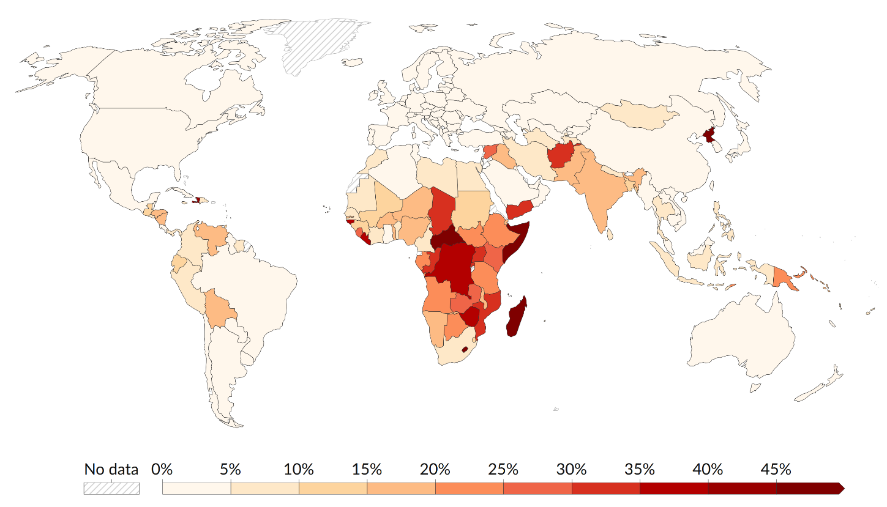
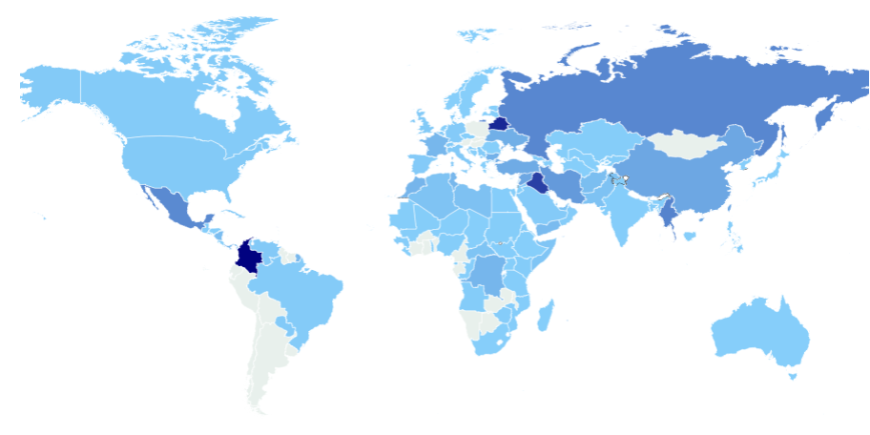
The impact of economic sanctions on food (prices) security– Discussion by A. Cheptea
Sanctioned countries experience tight food security concerns
⇒ share of share of undernourished population ⇒ number of sanctions
FAO 2021 data Global Sanctions Dashboard 2021 data

Slide 7
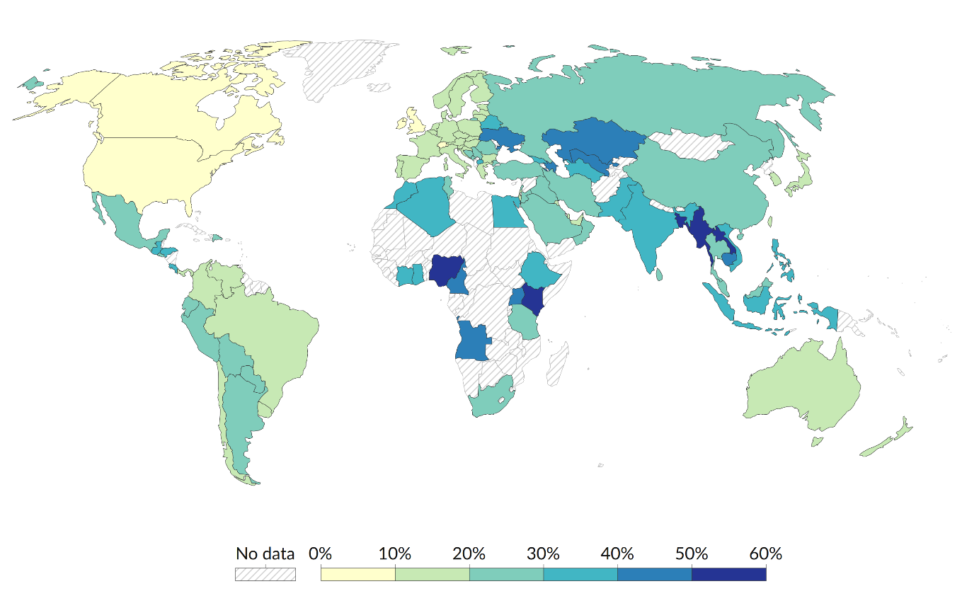
The impact of economic sanctions on food (prices) security– Discussion by A. Cheptea
Sanctioned countries experience tight food security concerns
⇒ share of consumer expenditure spent on food ⇒ number of sanctions
USDA ERS 2022 data Global Sanctions Dashboard 2021 data

Slide 8
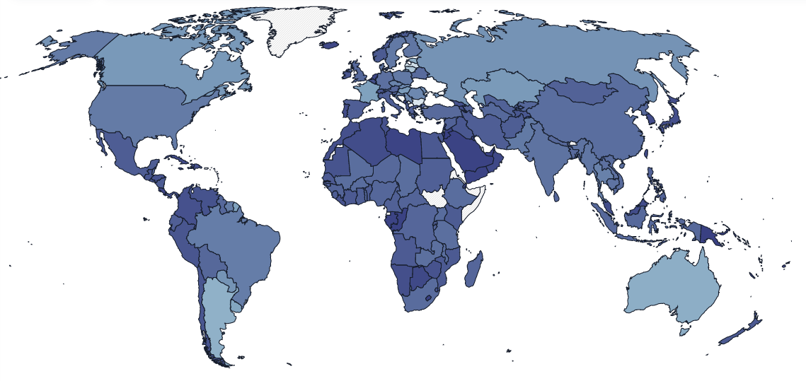
The impact of economic sanctions on food (prices) security– Discussion by A. Cheptea
Sanctioned countries experience tight food security concerns
⇒ cereal import dependency ratio ⇒ number of sanctions
WDI 2022 data Global Sanctions Dashboard 2021 data

Slide 9
The impact of economic sanctions on food (prices) security– Discussion by A. Cheptea
Comment 4: Homogeneous vs heterogeneous effect: some surprising results
The paper differentiates the effect of sanctions:
across their type: trade, financial and travel : differences not significant, but stronger impact when combined
across senders: EU, US, UN, other West: non significant effect of US sanctions, strong effect of UN sanctions
Allow for more nuanced effects across senders and targets
In a globalized world, the effect of sanctions can be amplified by the number of sending countries
Sanctions imposed by main economic partners may hurt more
Explore info on the stringency, span of sanctions (e.g. no. of sanctions at bilateral level, even by type)
Allow for different effects on introducing and on lifting sanctions
Minor comments:
Some control variables may be correlated ⇒ multicolinearity? may explain some surprising results
Tables 3 and 4: show mirror estimations without balancing to single out how it affects the ATT and R²

Slide 10
The impact of economic sanctions on food (prices) security– Discussion by A. Cheptea
Comment 4: Homogeneous vs heterogeneous effect: some surprising results
The paper differentiates the effect of sanctions:
across their type: trade, financial and travel : differences not significant, but stronger impact when combined
across senders: EU, US, UN, other West: non significant effect of US sanctions, strong effect of UN sanctions
Allow for more nuanced effects across senders and targets
In a globalized world, the effect of sanctions can be amplified by the number of sending countries
Sanctions imposed by main economic partners may hurt more
Explore info on the stringency, span of sanctions (e.g. no. of sanctions at bilateral level, even by type)
Allow for different effects on introducing and on lifting sanctions
Minor comments:
Some control variables may be correlated ⇒ multicolinearity? may explain some surprising results
Tables 3 and 4: show mirror estimations without balancing to single out how it affects the ATT and R²

Slide 11
The impact of economic sanctions on food (prices) security– Discussion by A. Cheptea
Minor comments: some confusions, inaccurate statements (in the manuscript)
“Sanctions often target agricultural and food products.”
This was the case in the 20th century, not in the 21st century
The case of Russia after its occupation of Crimea is not a good example
food prices increased due to Russia’s own policies and evolution of world prices, not sanctions
import embargo: Russia banned >50% of its food imports from EU and other Western countries
export revenues decreased due to lower oil prices and currency depreciation
sanctions by sender countries  policy measures of targeted countries, even if same effect on consumers
New research Q: Measures introduced by targeted countries alleviate or amplify the effect of sanctions?
Too strong wording: Sanctions rarely led to “an exponential increase in food prices”
Venezuela (hyperinflation), but not Russia (+15%), or Iran (+30%)

